Slide 1
Concur Expense Reporting August 2020

Slide 2
Topics Covered
Concur Expense Reporting
Signing in
Creating and Submitting an Expense Report
Using the Mobile App
Concur Support Desk
Concur for Reviewers and Approvers

Slide 3
Concur expense reporting software
What is it? How can I use this?

Slide 4
Expense Reports Then vs. Now
Old: Excel based reports ->
New: Concur Online and Mobile expense reports

Slide 5
Signing in to Concur
User Name and Password

Slide 6
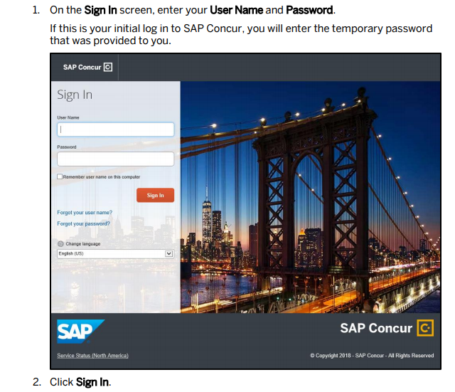
Sign in screen:
Navigate your web browser to:
www.concur.com
User name is your KHN email address:
Ex: Andy.Hill@ketteringhealth.org
Password: welcome
Change your password once you have access. The system will immediately prompt you to change it upon sign-in.

Slide 7
Changing your Default Password
Retrieving and Changing your Password
Password continued…

Slide 8
Updating your Profile (mostly optional)
Profile settings
Profile continued…

Slide 9
Creating an Expense Report
How to!

Slide 10
Creating an Expense Report: Start a report then add expenses
New Report: complete the fields (red asterisks denote required fields)
Select the expense type you want reimbursed!
Fill out the fields marked in red. “Report Key” is left blank and you may comment if you wish.

Slide 11
Expenses cont.
Expense Type: Exactly what it sounds like; hospitality, mileage, hotel, registration fees… etc.
Fill out the required boxes and any itemizations if needed.
Payment Type; “Personal” should be selected.
If you do not want this reimbursed check the box for “Personal Expense (do not reimburse).
Attach a receipt (either from a scanned copy or from your mobile device). Concur retains any scanned receipts for inclusion in current or future reports.
Resolve any errors or warnings that appear during the process.

Slide 12
Submitting your completed report
Once you submit your report it will go to your supervisor for review and approval.
Make sure you include receipts and resolve any errors or warnings before submission. This will help ensure your report continues smoothly through the process and is reimbursed timely.
Once approved by your supervisor it will continue on to payroll for reimbursement through your bi-weekly paycheck.
You can view the status of your report in the “Expense” section of Concur as it makes its way through the approval chain for payment. Reports are always available in your “report library” to review. There is no reason to print a hard copy.
NOTE: Concur currently limits reports to $20 or more. Please aggregate your expenses and submit when you have accumulated enough to submit.

Slide 13
Using the Mobile App (SAP Concur)
Concur works on your cellphone with Google (Android) or Apple (iOS)
Sign-in credentials will be the same as the website.
Activity is synchronized between the platforms: what you do on the website will show up on the App and vice versa.
Pro-tip! Scanning receipts is easy using your phone’s camera.
Concur for Android
Concur for iOS

Slide 14
Mobile App training
On the website: Navigate to “Help” -> “Training” then select “Android” or “iPhone”
Android app
iPhone app

Slide 15
Mobile App training: consider trying the App first before working through these guides. They are exhaustive and the App is relatively intuitive to use.
Android Quickstart Guide
iPhone Quickstart Guide

Slide 16
Concur Support Desk
Questions? Answers!

Slide 17
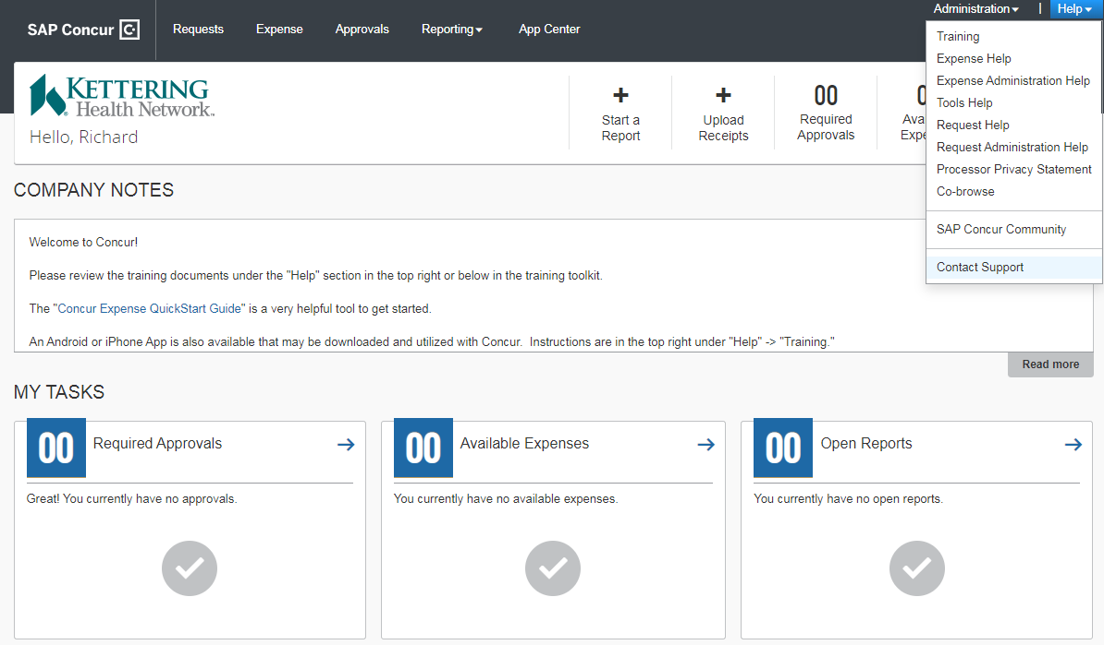
Concur Support Desk
Click “Help” in the top right after signing in to Concur.
Click “Contact Support”
Follow instructions to resolve issues!
If Support Desk is not able to resolve the issue and you have further questions please contact Andy Hill
Andy.hill@ketteringhealth.org
Ph.937-762-1633
Or on Teams

Slide 18
Concur as a Reviewer/Approver
How to!

Slide 19
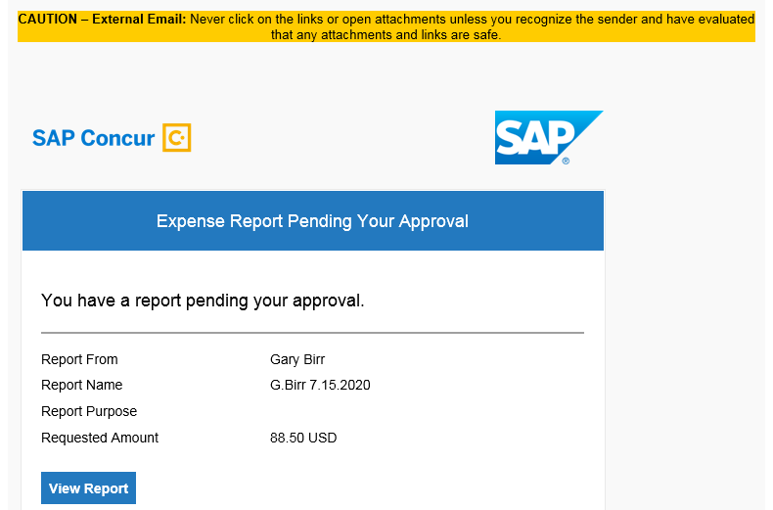
How to Review and Approve expense reports
As an approver, when a team member submits a report you will be notified by:
Work Email (@ketteringhealth.org)
App (if installed)
There will be a link in the email that will take you to Concur’s website or you may approve through the Concur App on your phone.

Slide 20
How to Review and Approve expense reports:
After signing in to the Concur website you will notice on the home screen a “Required Approvals” with a number other than “00,” indicating the number of reports that require your attention. Click it!
The next screen shows more detail; Select the report name.
Selecting the report name will bring up the detailed report and expenses that were submitted for reimbursement. As a reviewer you have the same rights and responsibilities:
Assure the expenses are valid and appropriately coded to the correct cost center.
Review attached receipts for completeness and validity of submitted expenses.
Decision the report:
“Send back” if it needs further information (be sure to follow up w/ employee)
“Approve” if the report is in order and is within your dollar approval threshold.
“Approve and Forward” to your VP or director if the report is above your approval threshold.

Slide 21
End of Presentation
Thank you for reviewing the Concur training document.
A special thank you to the teams and individuals who dedicated time and expertise to this project.

