Slide 1
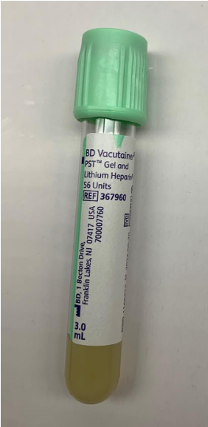
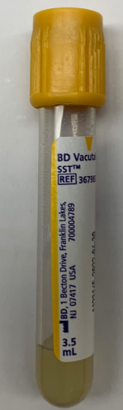
Effective 9/16/21 Conservation of Blood Tubes when drawing “rainbow” labs
Only 1 Green Top needed (do NOT draw 2 even if prompted by Epic labels)
Add a Gold top ONLY for
Procalcitonin, Lithium, Salicylate or GGT orders
Additional reminders
Only use tubes with orders.
Do not draw additional tubes without orders.
Send all unused labels to the lab with the specimen.

