Slide 1
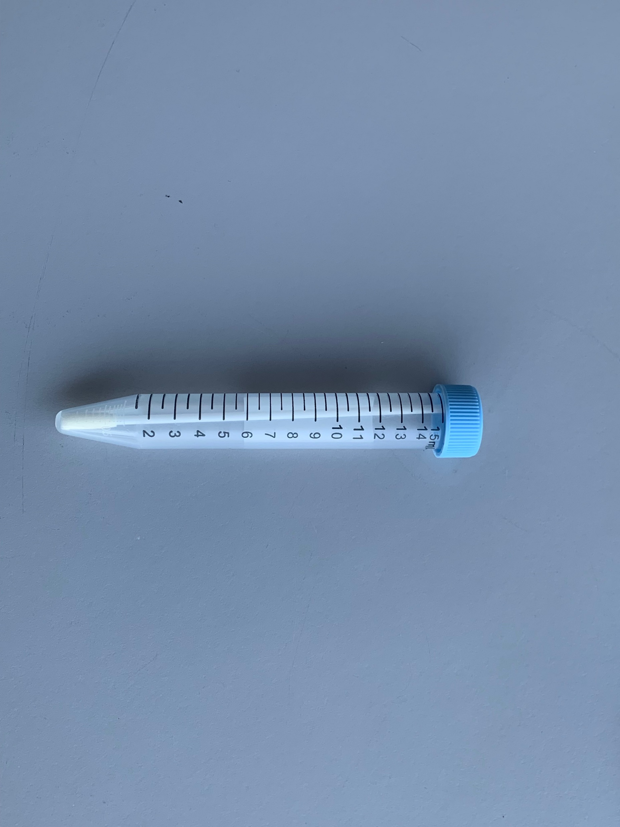
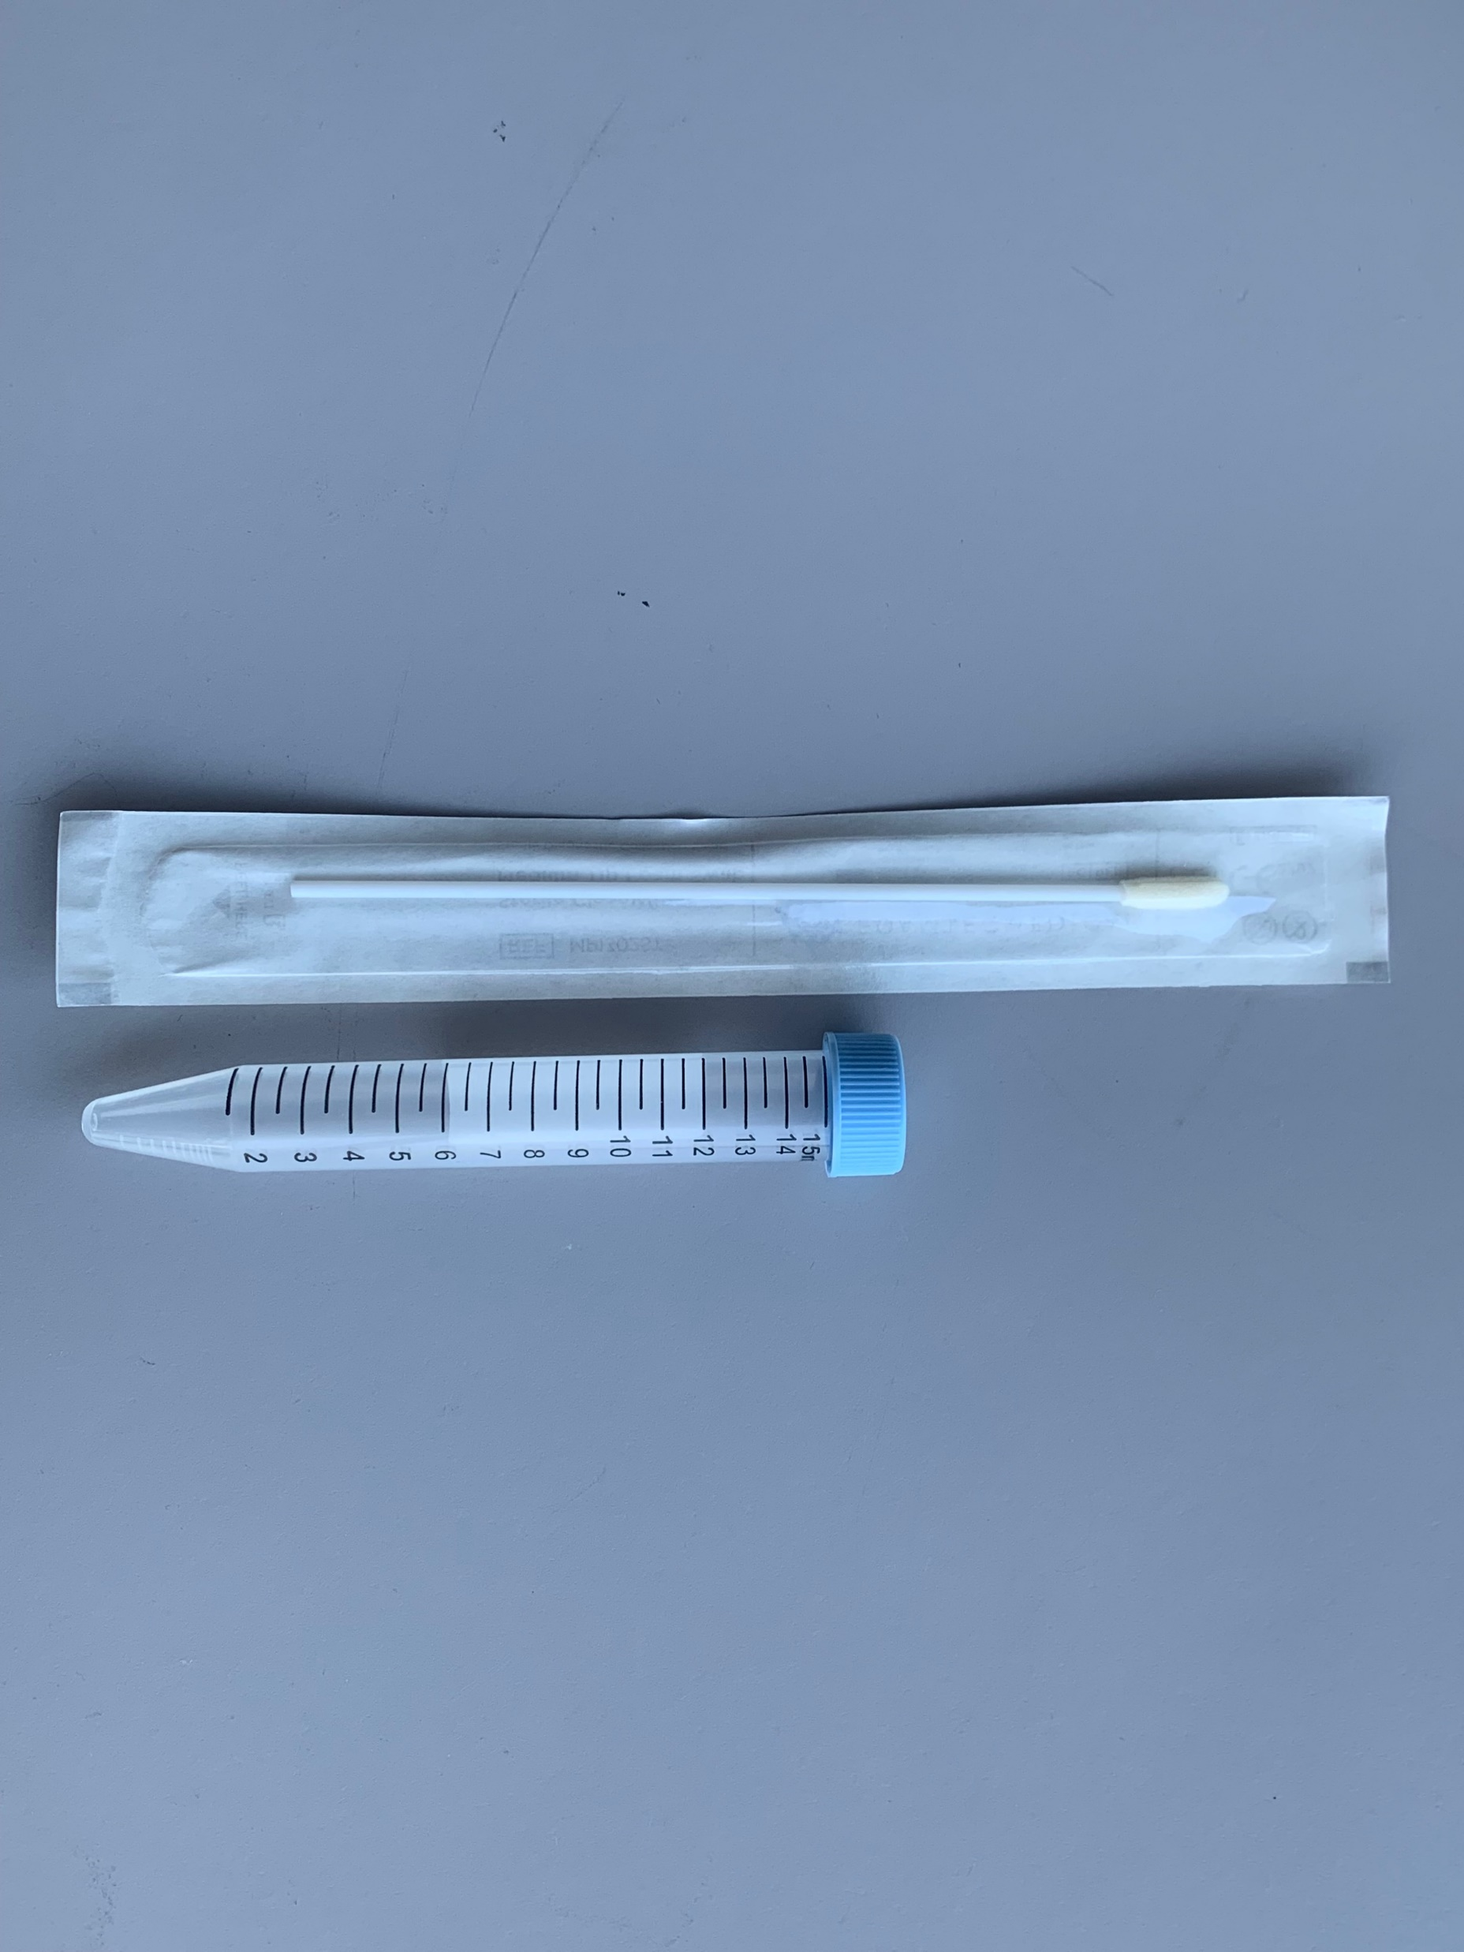
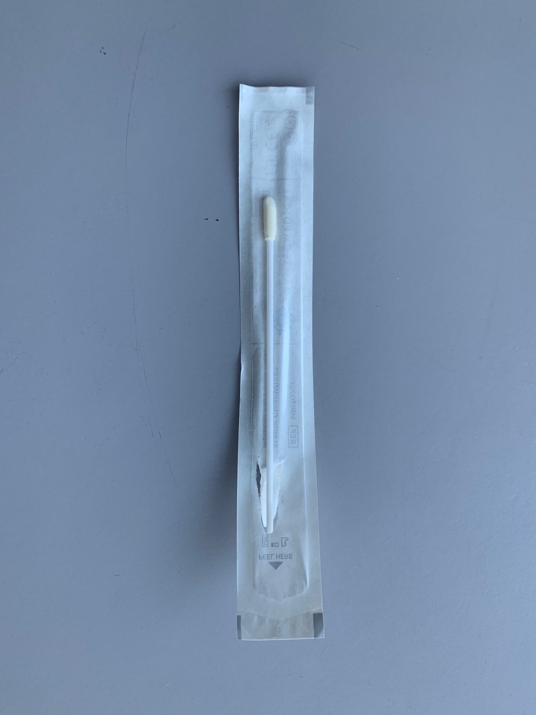
New Swab Container for Rapid COVID Samples
Rapid COVID swabs can only be placed into blue tube after use. Lab will send blue top up with rapid swab.
Due to a manufacturing version change to reagent the Rapid COVID swabs can no longer go back into the original packaging once the swab is used to collect a sample. It must now be put into the clear tube with the blue lid shown above. The swab will have to be broken off to fit fully into the tube.
*The swab will have to be broken off to fit fully into the tube*
Practice change will occur System wide- Tuesday, November 15th
**No change for Rapid Flu and Strep samples- they can still go back into original packaging**

